Slide 1

Sign Language gesture recognition
Presented by: Shady Mahmoud Ahmed Elkholy 1751710378
Supervisor: DR. Sara Nabil

Slide 2
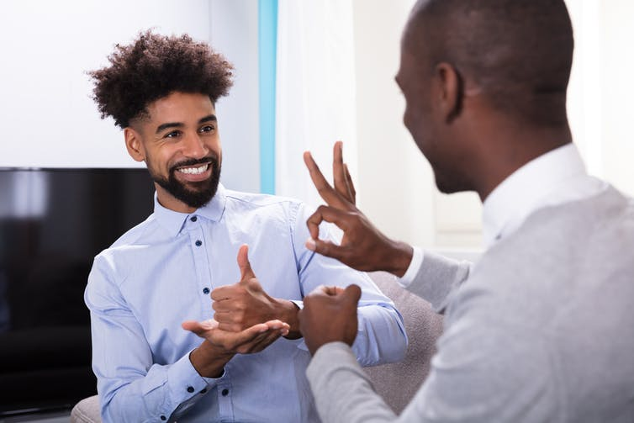
What is sign language?
Communication language used by the hearing-impaired to communicate with people
Uses hand, face, eyes and gestures to form words instead of using vocal cords to communicate.

Slide 3
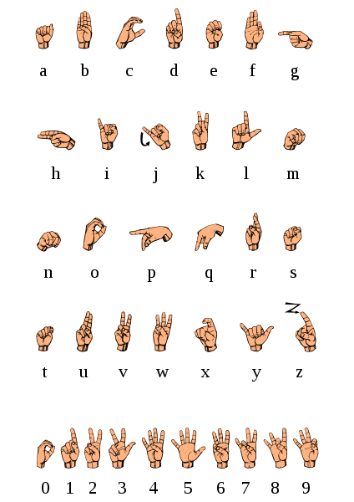
What is American sign language?
Here are the 26 letters and first 10 numbers of ASL.

Slide 4
What is a Sign Language recognizer?
Sign language recognizer or (SLR) for short is a tool for recognizing sign language gestures made by hand using either vision or sensors to capture them.

Slide 5
Why the need of SLR?
According to the World Health Organization (WHO) over 5% of the world’s population or 430 million people have disabling hearing loss. Which is not hearing over 35 decibels(dB) and that number is projected to grow to 700 million by 2050. A huge percentage of these 430 million use different sign languages to communicate. The need of SLR is to give them a tool to help them communicate with people who don’t know sign language.

Slide 6
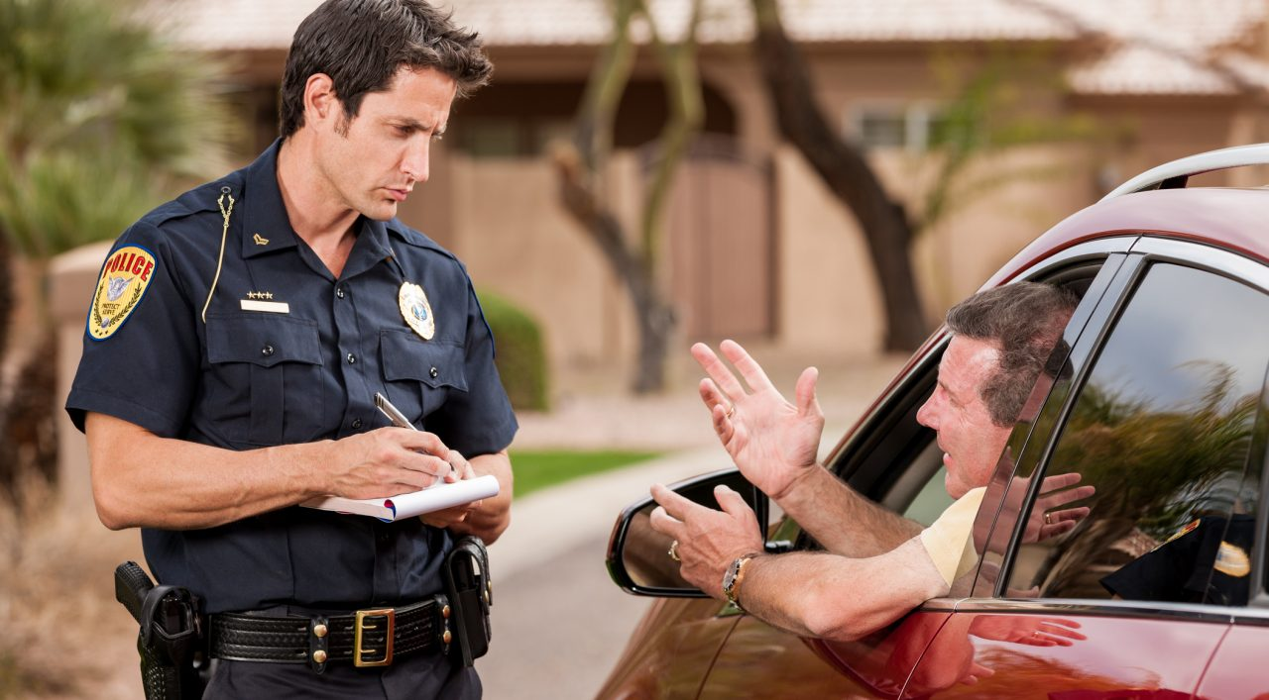
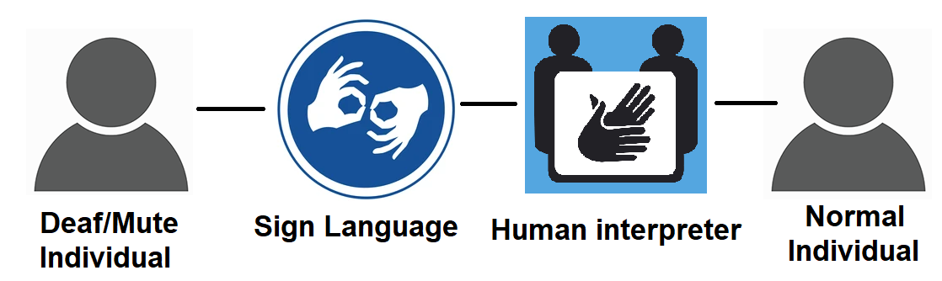
How would SLR help?
If a deaf or mute person had an accident and the police where on scene, They will not be able to properly communicate with them due to the communication barrier and it will be difficult to get the point across. SLR would help in that situation.

Slide 7
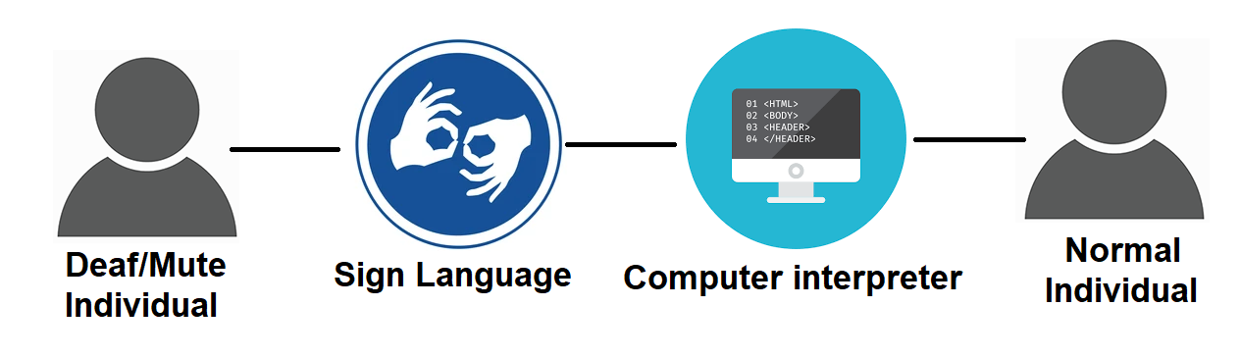
Continued…
SLR would capture signs from deaf/mute person.
SLR coverts signs to text.
Text is converted to speech or shown to the police officer.
Now the police officer knows the situation and can act accordingly.

Slide 8
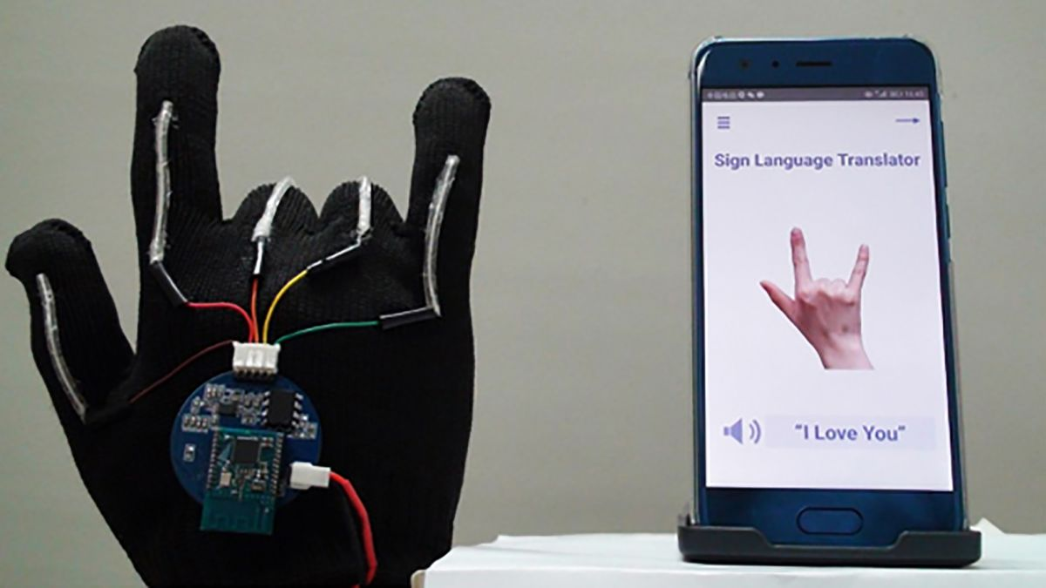
Related Work
Students in a university in San Diego, USA called University of California successfully made a glove that interprets the 26 letters of ASL but no sentences support.

Slide 9
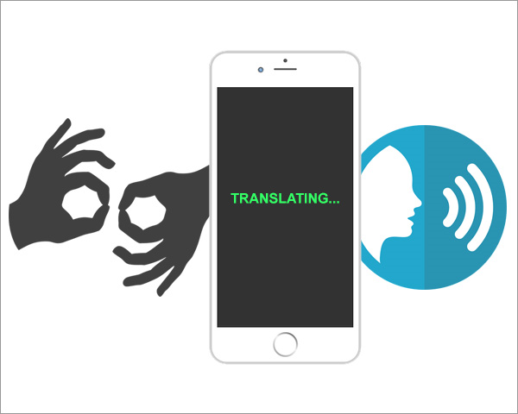
Related Work
A Dutch start-up called Evalk is working on a smartphone app that interprets sign language from the phone’s video feed and translate it into speech in real-time, but it’s not yet available for public use.

Slide 10
Related Work
This project aims to have flawless continuous real-time interpretation with good accuracy.

Slide 11
How Does an SLR work?
Image processing & gesture detection
• Image Capture •Skin Color detection •Hand gesture detection
Normalization
Sign recognition
Output

Slide 12
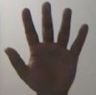
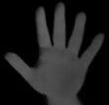
How Does an SLR work?
Image processing & gesture detection
•Reduce image resolution •Gray scale image •Reduce image noise
Normalization
Sign recognition
Output
30x30 px
200x200 px

Slide 13
How Does an SLR work?
Image processing & gesture detection
•Neural network implementation.
•Dataset implementation
Normalization
Sign recognition
Output

Slide 14

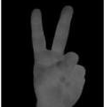
How Does an SLR work?
Image processing & gesture detection
•Converting sign language to English text and speech.
Normalization
Sign recognition
V
Output

Slide 15
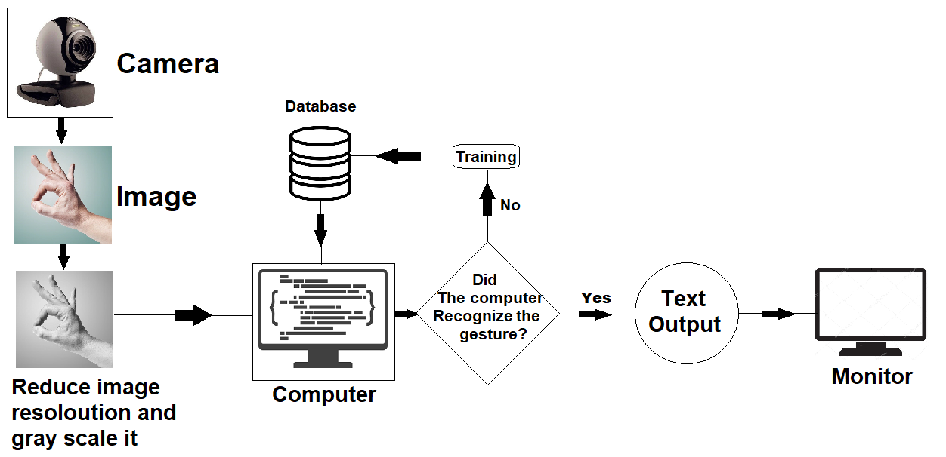
Block diagram of the project:

Slide 16
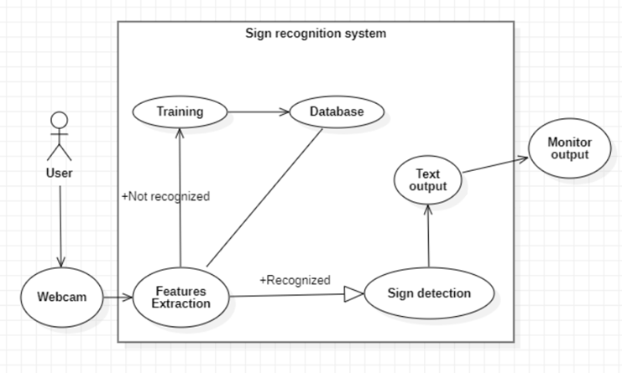
Use case diagram:

Slide 17
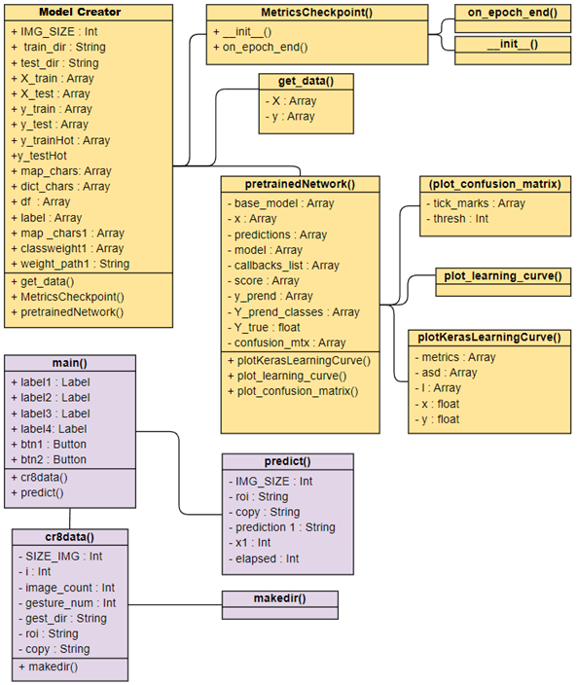
Class Diagram:

Slide 18
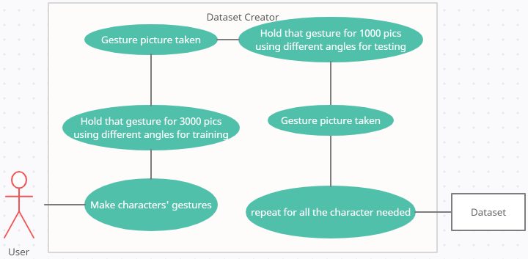
Dataset creation:

Slide 19
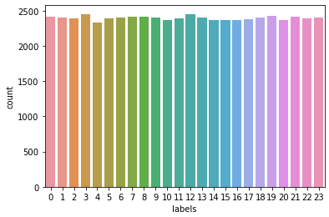
Dataset:
After establishing our dataset using that method, we might start training the model using that dataset. There’s a total of 24 gestures for which the model is going to be trained to do, which is the alphabet minus the “J” and “Z” characters because they require a motion gesture.
Every image will be labeled with its corresponding label. So, if an “H” Character it will be in an “H” folder and will have “H” label and so on.
Then every character will be hot vectored and then shuffled for subsampling, this part is the pre-procession part which is one of the most important in any machine learning project. After shuffling the character with the hot vectored labels, we will find that they are not equal in numbers anymore because we lost some characters more than others.

Slide 20
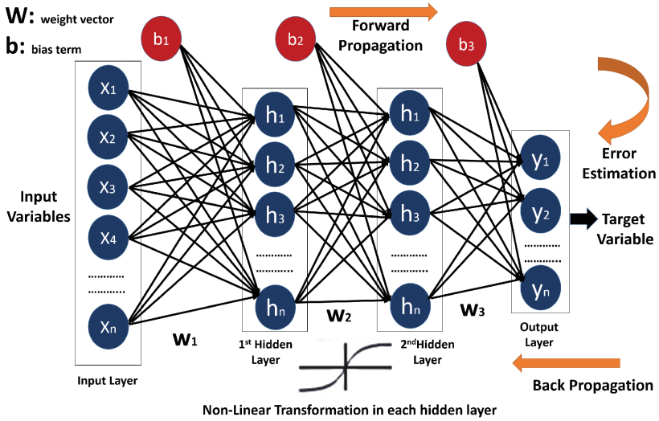
Our model design:
We use a multi-layer neural network design, specifically 5 layers.
We train that model with out custom made dataset to tailor it to our needs.

Slide 21
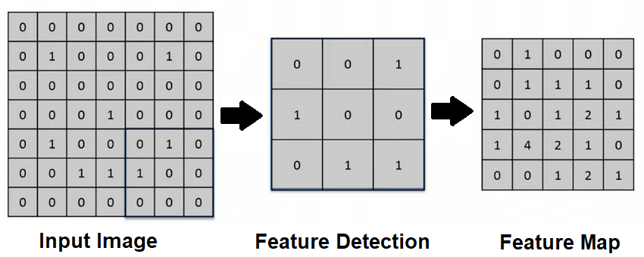
Convolution layer:
The first layer of CNN is the convolution layer.
Convolution layer uses kernels to detect the features of an image such as edges. It detects all the features it can from the image and puts them in a feature map.

Slide 22
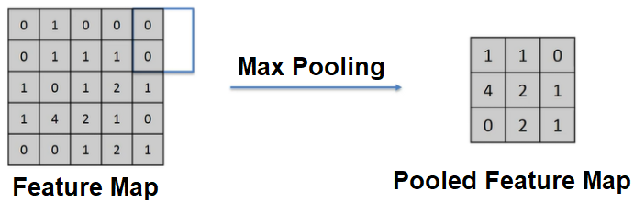
Max Pool layer:
Max pooling is the layer responsible for reducing the size of the feature map.
This is done so it would take less computational power to process all the feature maps available.

Slide 23
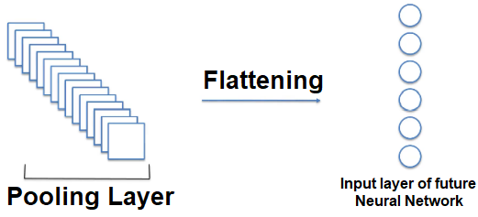
Flatten layer:
The pooled feature maps from the max pool layer will then be flattened.
Flattening is converting the feature maps into long vectors of input data which will be used as input.

Slide 24
The model’s layers:
Layer (Type) | Output Shape
input image (Input Layer) | (None, 50, 50, 3)
block1_conv (Conv2D) | (None, 50, 50, 64)
block1_pool (MaxPooling2D) | (None, 25, 25, 64)
block2_conv (Conv2D) | (None, 25, 25, 128)
block2_pool (MaxPooling2D) | (None, 12, 12, 128)
block3_conv (Conv2D) | (None, 12, 12, 256)
block3_pool (MaxPooling2D) | (None, 6, 6, 256)
block4_conv (Conv2D) | (None, 6, 6, 512)
block4_pool (MaxPooling2D) | (None, 3, 3, 512)
block5_conv (Conv2D) | (None, 3, 3, 512)
block5_pool (MaxPooling2D) | (None, 1, 1, 512)
flatten (Flatten) | (None, 512)
This is the 5 layer model I’m using in this project and since it’s 5 layers it will use the same layers mentioned in the previous slides 5 times and then it gets flattened so it can be used as input later on.

Slide 25
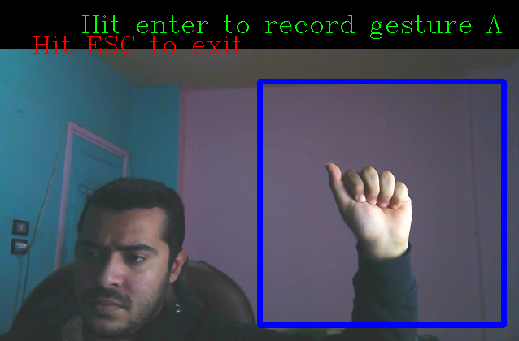
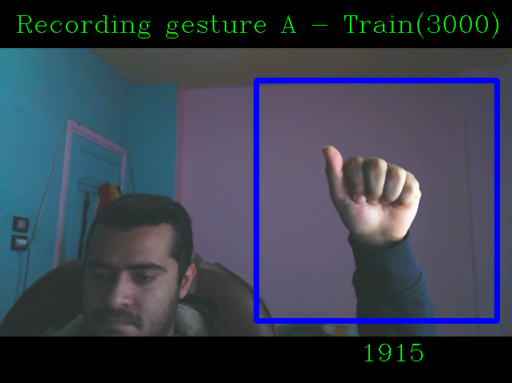
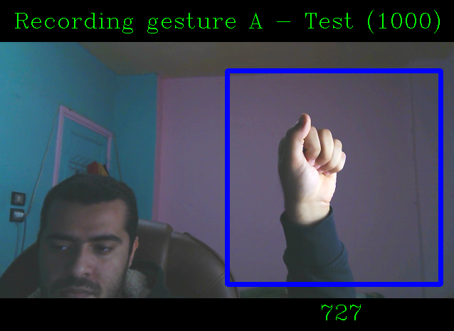
Making the dataset:
The user is asked to gesture a letter and then the user is expected to press enter when ready. When Enter is pressed the program will start taking pictures of the gesture in the specified Region of interest. The program will take 3000 pictures for training purposes and 1000 for testing purposes.
If the user wishes to end the process early they can press the Escape key on the keyboard. And if they want to take less than 3000 or 1000
pictures they can press enter and it
will end instantly.
The saved pictures will be saved in a folder with their corresponding letter so it can be used later in the model.

Slide 26
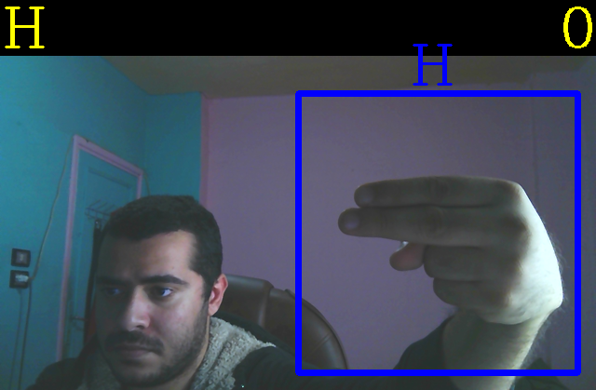
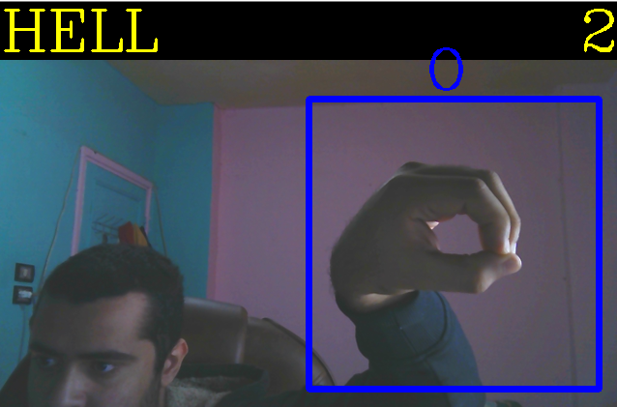
Prediction:
The user is expected to gesture the letter they want to be interpreted in the specified region of interest marked with the blue rectangle.
When the user gestures the model will try to predicts which letter the user is gesturing and display it.
If the same gesture is made for 3 continuous seconds it will be saved in a string.
This was the user can spell out words by gesturing each letter.
To reset the word the user can press the key “Tab” on their keyboard and to quit the prediction window they can press they key “Escape”.

Slide 27
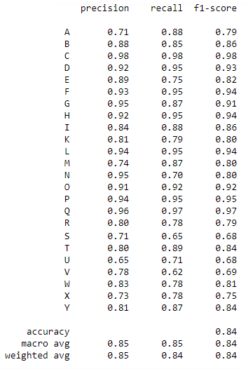
Model performance:
1- Precision: is a performance metric which represents the percentage of the results of the model which are relevant to the model.
2- Recall: is a performance metric which represents the percentage total of total pertinent results classified correctly by the machine learning algorithm.
3- F1-score: is a performance metric which is the combination of both precision and recall into a single parameter. F1-score is a simple way to compare classifiers. F1-score is also a harmonic metric unit. Which means it gives much more weight to low values, that means that f1-score will get a high number only if both recall and precision are high.

Slide 28
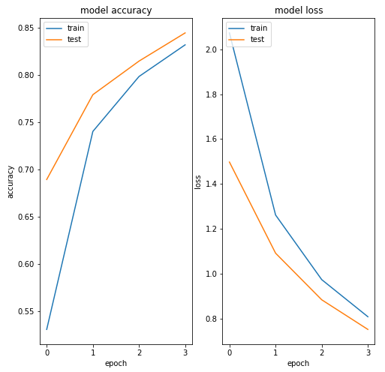
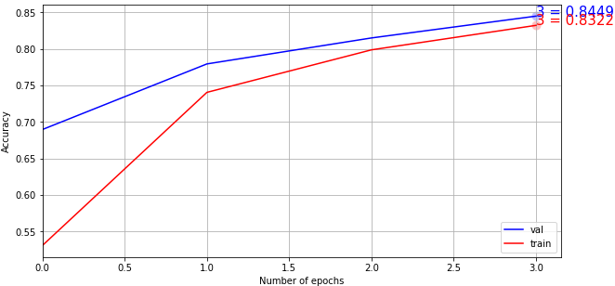
Model performance:

Slide 29
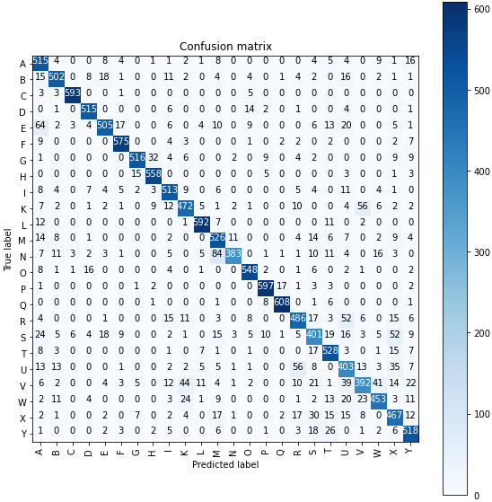
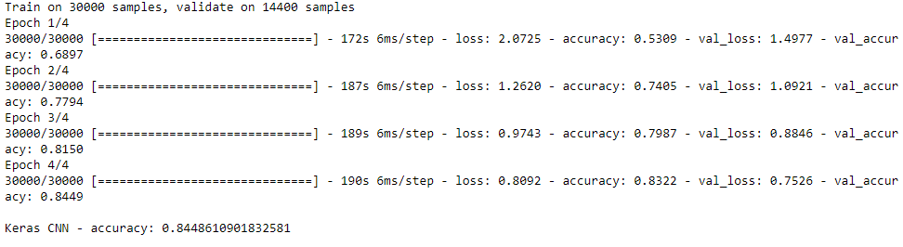
Model performance:
The confusion matrix of the model is good and is performing better than expected.
The model was trained with 4 epochs only.
When the model was trained on 40 and 10 epochs it was later found that it was over-fitted and 4 epochs were the best prediction performance I’ve found.

Slide 30
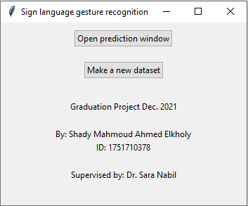
User interface:
A user-friendly Interface was created using Tkinter library. It includes buttons for Making the dataset which will open a window that takes pictures of gestures for the dataset from the camera feed which was explained earlier.
The user interface also has a button for opening up the prediction window which will open a camera feed and the user is then expected to gesture the character they want the program to predict in the specified frame which was explained earlier.
The user interface also has some text saying my name, ID, and who supervised this project.

Slide 31

Further work:
The project has a lot of performance improvements to be made which can be done by making a better dataset and optimizing the model it self.
I would like to add numbers in the future but the challenge lies with them being too close to the alphabet gestures.
I would like to add whole words which wouldn’t be hard I would just train the model on them.
I would like to add the 2 missing alphabet letter that require motion to be done which will open the door for other more complex motion based gestures.
I would like to add the text to speech functionality that isn’t dependent on being connected to the internet.

Slide 32

Limitations:
The project has some limitations that aren’t easily addressable.
The software will fail to work in accelerated motions.
The user can’t use both hands to gesture.
Bad lighting and skin colour similar to the background will confuse the software.
Motion based gestures don’t work with the current specifications.

Slide 33
References:
Aniruddha Bhandari, 2020. Everything you Should Know about Confusion Matrix for Machine Learning. [Online] Available at: https://www.analyticsvidhya.com/blog/2020/04/confusion-matrix-machine-learning/ [Accessed 09 December 2021].
Baeldung, 2021. Epoch in Neural Networks. [Online] Available at: https://www.baeldung.com/cs/epoch-neural-networks [Accessed 10 December 2021].
Bari, Anasse; Chaouchi , Mohamed; Jung, Tommy;, 2016. How Predictive Analysis Neural Networks Work. [Online] Available at: https://www.dummies.com/article/technology/information-technology/ai/machine-learning/how-predictive-analysis-neural-networks-work-154308 [Accessed 11 December 2021].
geeksforgeeks, 2020. Python GUI – tkinter. [Online] Available at: https://www.geeksforgeeks.org/python-gui-tkinter/ [Accessed 12 December 2021].
Huang, J. et al., 2018. Video-based Sign Language Recognition without Temporal Segmentation, Hefei: University of Science and Technology of China.
IBM, 2020. What are neural networks?. [Online] Available at: https://www.ibm.com/eg-en/cloud/learn/neural-networks [Accessed 02 December 2021].
Iryna Sydorenko, 2021. What Is a Dataset in Machine Learning: Sources, Features, Analysis. [Online] Available at: https://labelyourdata.com/articles/what-is-dataset-in-machine-learning [Accessed 05 December 2021].
Jason Brownlee, 2019. A Gentle Introduction to Pooling Layers for Convolutional Neural Networks. [Online] Available at: https://machinelearningmastery.com/pooling-layers-for-convolutional-neural-networks/ [Accessed 10 December 2021].
Jiwon Jeong, 2019. The Most Intuitive and Easiest Guide for Convolutional Neural Network. [Online] Available at: https://towardsdatascience.com/the-most-intuitive-and-easiest-guide-for-convolutional-neural-network-3607be47480 [Accessed 10 December 2021].
Joos Korstanje, 2021. F1 score. [Online] Available at: https://towardsdatascience.com/the-f1-score-bec2bbc38aa6 [Accessed 09 December 2021].
Martin Riva, 2021. Interpretation of Loss and Accuracy for a Machine Learning Model. [Online] Available at: https://www.baeldung.com/cs/ml-loss-accuracy [Accessed 10 December 2021].
Nahua Kang, 2017. Multi-Layer Neural Networks with Sigmoid Function— Deep Learning for Rookies. [Online] Available at: https://towardsdatascience.com/multi-layer-neural-networks-with-sigmoid-function-deep-learning-for-rookies-2-bf464f09eb7f [Accessed 03 December 2021].
National insitute on deafness and other communication disorders, 2021. American Sign Language. [Online] Available at: https://www.nidcd.nih.gov/health/american-sign-language [Accessed 01 December 2021].
NewzHook, 2018. GnoSys app translates sign language into speech in real time using the power of AI. [Online] Available at: https://newzhook.com/story/20387/ [Accessed 17 May 2021].
O’Connor, T. F. et al., 2017. The Language of Glove: Wireless gesture decoder with low-power and stretchable hybrid electronics, San Diego: University of California.
Sumit Saha, 2018. A Comprehensive Guide to Convolutional Neural Networks. [Online] Available at: https://towardsdatascience.com/a-comprehensive-guide-to-convolutional-neural-networks-the-eli5-way-3bd2b1164a53 [Accessed 05 December 2021].
Techopedia, 2018. Single-Layer Neural Network. [Online] Available at: https://www.techopedia.com/definition/33267/single-layer-neural-network [Accessed 02 December 2021].
Upasana, 2019. Difference between Loss, Accuracy, Validation loss, Validation accuracy in Keras. [Online] Available at: https://www.javacodemonk.com/difference-between-loss-accuracy-validation-loss-validation-accuracy-in-keras-ff358faa [Accessed 09 December 2021].

Slide 34

Thank you!
Thank you for your time and I am open to any questions you may have!
I would like to thank my mentor Dr. Sara Nabil for giving me the opportunity to undertake this project. I would like to thank her for her immense guidance and appreciate her timely engagement.

